Slide 1
XXII International Workshop “What comes beyond the Standard Models”,06-14 July 2019, Bled, Slovenia Search for a solution to the problem of a cosmic gamma background in explaining the e⁺(e⁻) - anomaly in cosmic rays
Ekaterina Shlepkina*, Konstantin Belotsky, Airat Kamaletdinov,Maxim Soloviev
NRNU MEPhI, Moscow
Department of elementary particles physics
*speaker, sponsored by MDPI “Particles” award for student’s scientific debut

Slide 2
Cosmic rays experiments
PAMELA
Satellite: “Resurs DK-1”
Since: 15 June 2006
The study of fluxes of antiparticles in cosmic rays in the range from ~ 100 MeV to hundreds of GeV.
AMS – 02
Installed on the ISS
Since: 16 May 2011
Designed to study the composition of cosmic rays, the search for antimatter and dark matter
Fermi-LAT
Space gamma telescope
Since: 11 June 2008
The study of astrophysical and cosmological processes in the centers of galaxies, gamma-ray bursts, the search for dark matter

Slide 3
Positron anomaly

Slide 4
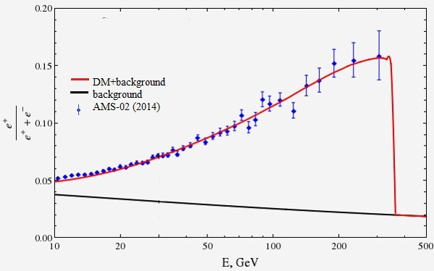
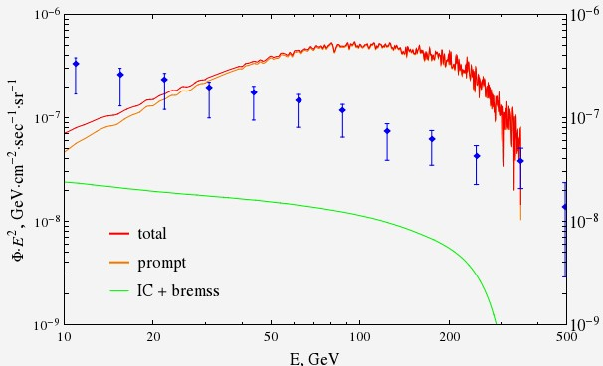
Contradictions with gamma data (dark halo model)
Agrees with positron data
ee,μμ,ττ
Contradictions with IGBR

Slide 5
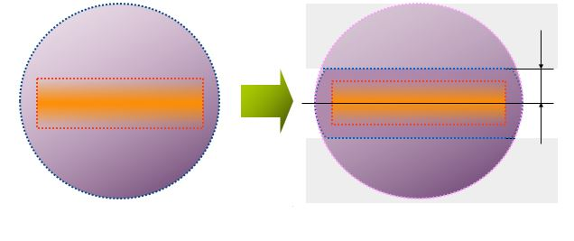
Possible ways of gamma suppression
DM halo
Stable DM
Due to space DM distribution (dark halo and dark disk models, clumps)
Physics of DM interaction:
???
h
Star disk
Unstable DM
Standard Model particles
{e⁺,e⁻,γ …}

Slide 6
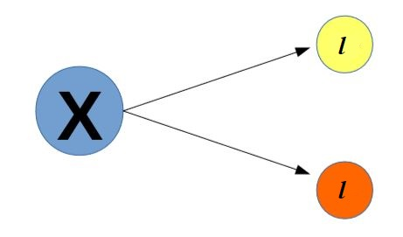
Possible DM interaction types
We consider the decay of a hypothetical massive particle X into two leptons:
DM particle X can be:
Scalar
Pseudoscalar
Vector
Axial vector

Slide 7
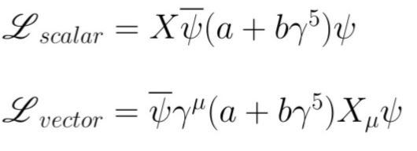
Parametrization of interaction Lagrangian
The idea is to use different combinations of vector and pseudo-vector coupling, or scalar and pseudoscalar, to understand which coupling constants must be chosen in order to suppress a FSR.
Then suppression of a FSR means that:

Slide 8
e⁺e⁻ - decay model
The first model of dark matter, which (we) was considered by our scientific group, was a DM model consisting of particles X interacting with opposite charged leptons (in our case positron and electron):
X → e⁺ e⁻
X → e⁺ e⁻ γ
After modeling this process and analyzing the results, we can conclude that the considered cases do not allow suppressing FSR.
That is we obtained that ratio $\frac{σ(X→e e γ)}{σ(X→e e)}$ does not depend on the parameters a and b in interaction Lagrangian.

Slide 9
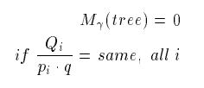
Background to the two-positron modes
The model of the “dark atom”
M.Yu. Khlopov, JETP Lett. 83 (2006) 1;
D. Fargion, M.Khlopov, C.Stephan, Class. Quantum Grav. 23 (2006) 7305;
M. Y. Khlopov and C. Kouvaris, Phys. Rev. D 77 (2008) 065002]
Absolute suppression of dipole radiation when emitting two single charged particles in the classic (Correspondence principle)
The need to find the area of kinematic parameters where it is possible to suppress FSR (Single-photon theorem)
One photon per two positrons.
Suppression of the radiation is interesting in itself from the point of view of quantum physics.
Brown, R. W. "Understanding Something about Nothing: Radiation Zeros, published in Vector Boson Symp. 1995: 261-272. RW Brown, KL Kowalski and SJ Brodsky." Phys. Rev. D 28 (1983): 624.

Slide 10
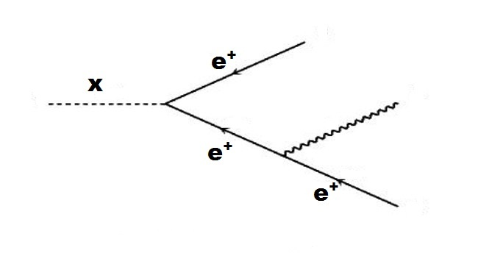
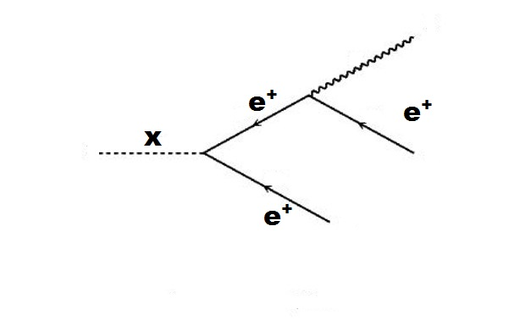
Two-positrons decay model
We consider (for the sake of searching the principal possibility of suppression) the dark matter models consisting of hypothetical long-lived double-charged massive (~1 TeV) particles X, interacting with identical positrons in the final state: X⁺⁺ → e⁺ + e⁺ and X⁺⁺ → e⁺ + e⁺ +γ
To build this mode, obtain Feynman rules and test this model at the diagram level, we used the package FeynRules and MC-generator MadGragh.
$L=X\overline{ψ^{c}}\left(a+bγ^{5}\right)ψ+X\overline{ψ}\left(a−bγ^{5}\right)ψ^{с}+\overline{ψ}γ^{μ}A_{μ}ψ$
γ
γ

Slide 11
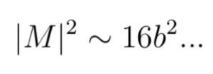
Results for two-positrons model
To obtain the squared matrix elements of the above processes, LanHEP and CalcHEP packages were used.
For scalar X
X → e⁺ + e⁺
X → e⁺ + e⁺ +γ
For vector X
X → e⁺ + e⁺
X → e⁺ + e⁺ +γ
Ratio of decay widths does not depend on a and b parameters. Thus, we can conclude that in decays of this type of particle, the FSR is not suppressed, due to parameters a,b.

Slide 12
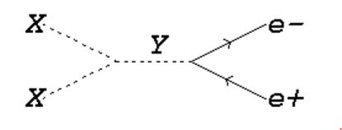
The DM model with a heavy intermediate particle
It is necessary to complicate the models, therefore in the following, we consider the decay of an uncharged self-conjugate particle X into Y (Q = +2), $\overline{Y}$ (Q=-2) and annihilating DM models:
e-
$$\overline{Y}$$
Thus, we can consider different variations of such a model:
X,Y – scalars;
X-vector, Y-scalar;
X,Y-vectors;
X-scalar,Y-vector;
…
e-
X
Y
e+
$$γ$$
e+

Slide 13
Results for the DM model with a heavy intermediate particle
Decay models:
1) X,Y – scalars:
In this case, there was also a reduction in parameterization.
2) X – vector, Y – scalar:
${\left|M\right|}^{2}$= 0 (two-body decay)
Annihilating DM models:

Slide 14
Model of fermion dark matter with a heavy mediator
The next step in this work was to consider the model of the dark matter consisting of spinor charge-conjugated massive particles X with charge +1.
Interaction Lagrangian is follows:

Slide 15
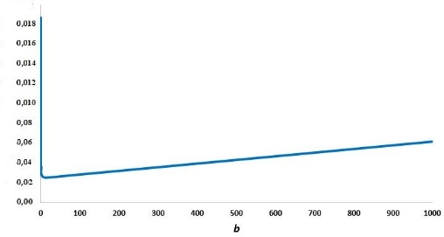
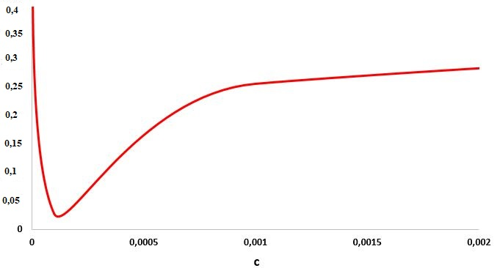
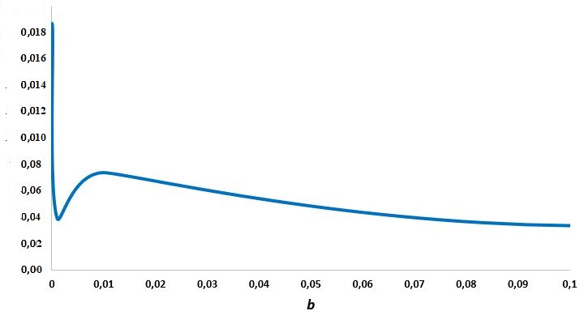
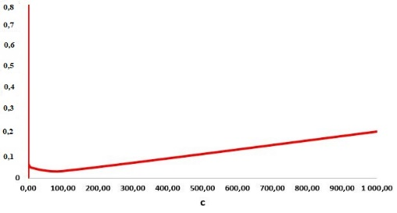
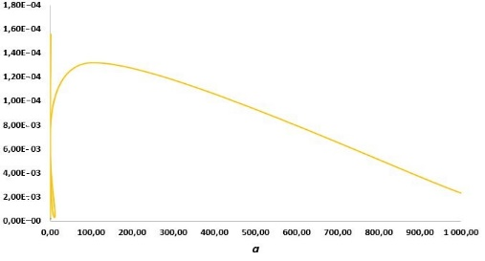
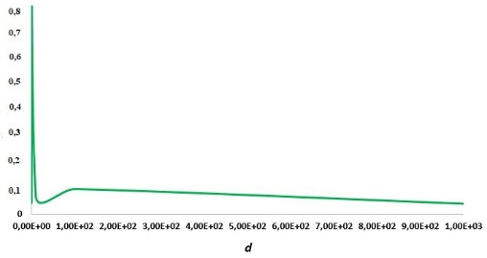
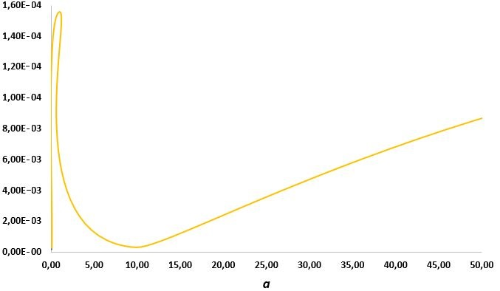
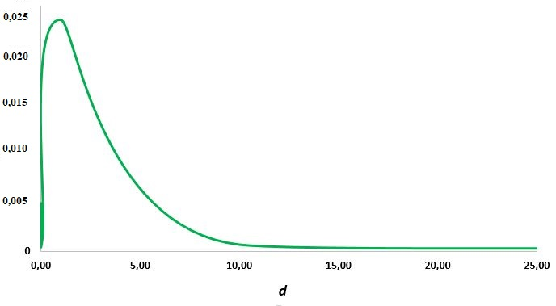
Dependence on model parameters

Slide 16
Conclusion
When considering the decays of vector and scalar dark matter particles in two-lepton modes (electron and positron), it turned out that in these situations the parametrization of the interaction Lagrangian does not give any positive results.
We considered the decays of a vector and a scalar particle of dark matter into two identical positrons. It turned out that the FSR is not suppressed in these models.
Were considered more complex models of dark matter with a massive intermediate particle. Studied various variations of such models.
In the next step, models of fermion dark matter were considered. It was found that in such a model, no parameterization reduction occurs. FSR energy distributions were obtained for different variations of the parameters a, b, c, d.

Slide 17
Thank you for attention!
Shlepkina Ekaterina
+7 (980)5122-503
shlepkinaes@gmail.com

Slide 18
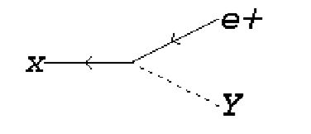
Plans
Continue to develop a fermion model of dark matter
More detailed study of model dependencies on parameters
How does the theorem work in these models?
Consideration of another promising model of dark matter where no cancelation of parameters is observed:

Slide 19
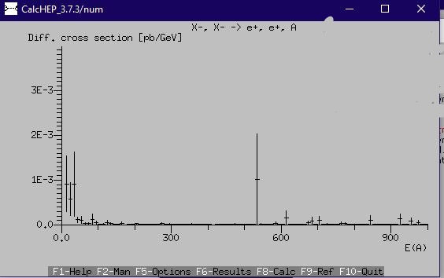
FSR energy spectra for the fermion model
FSR energy spectra
FSR energy spectra with modified parameters a,b,c,d

